Slide 1
Fitting with drjacoby
Bob Verity, Pete Winskill

Slide 2
The schedule
2:00 - 2:15 Why use drjacoby?
2:15 - 2:45 Basic MCMC – Bayesian regression example
2:45 – 3:15 Model testing – Model comparison and model fit
3:15 – 3:45 Improving mixing – Parallel tempering
3:45 – 4:15 Linking with other packages – Compartmental model in Odin
4:15 – 5:00 Speeding up – C++ and running in parallel

Slide 3
Why use drjacoby?

Slide 4
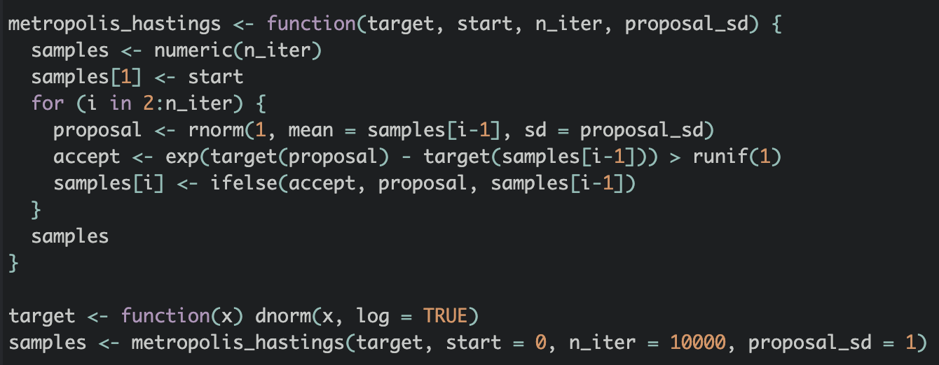

Anyone can write an MCMC!
This will explore any target distribution if run for long enough!

Slide 5
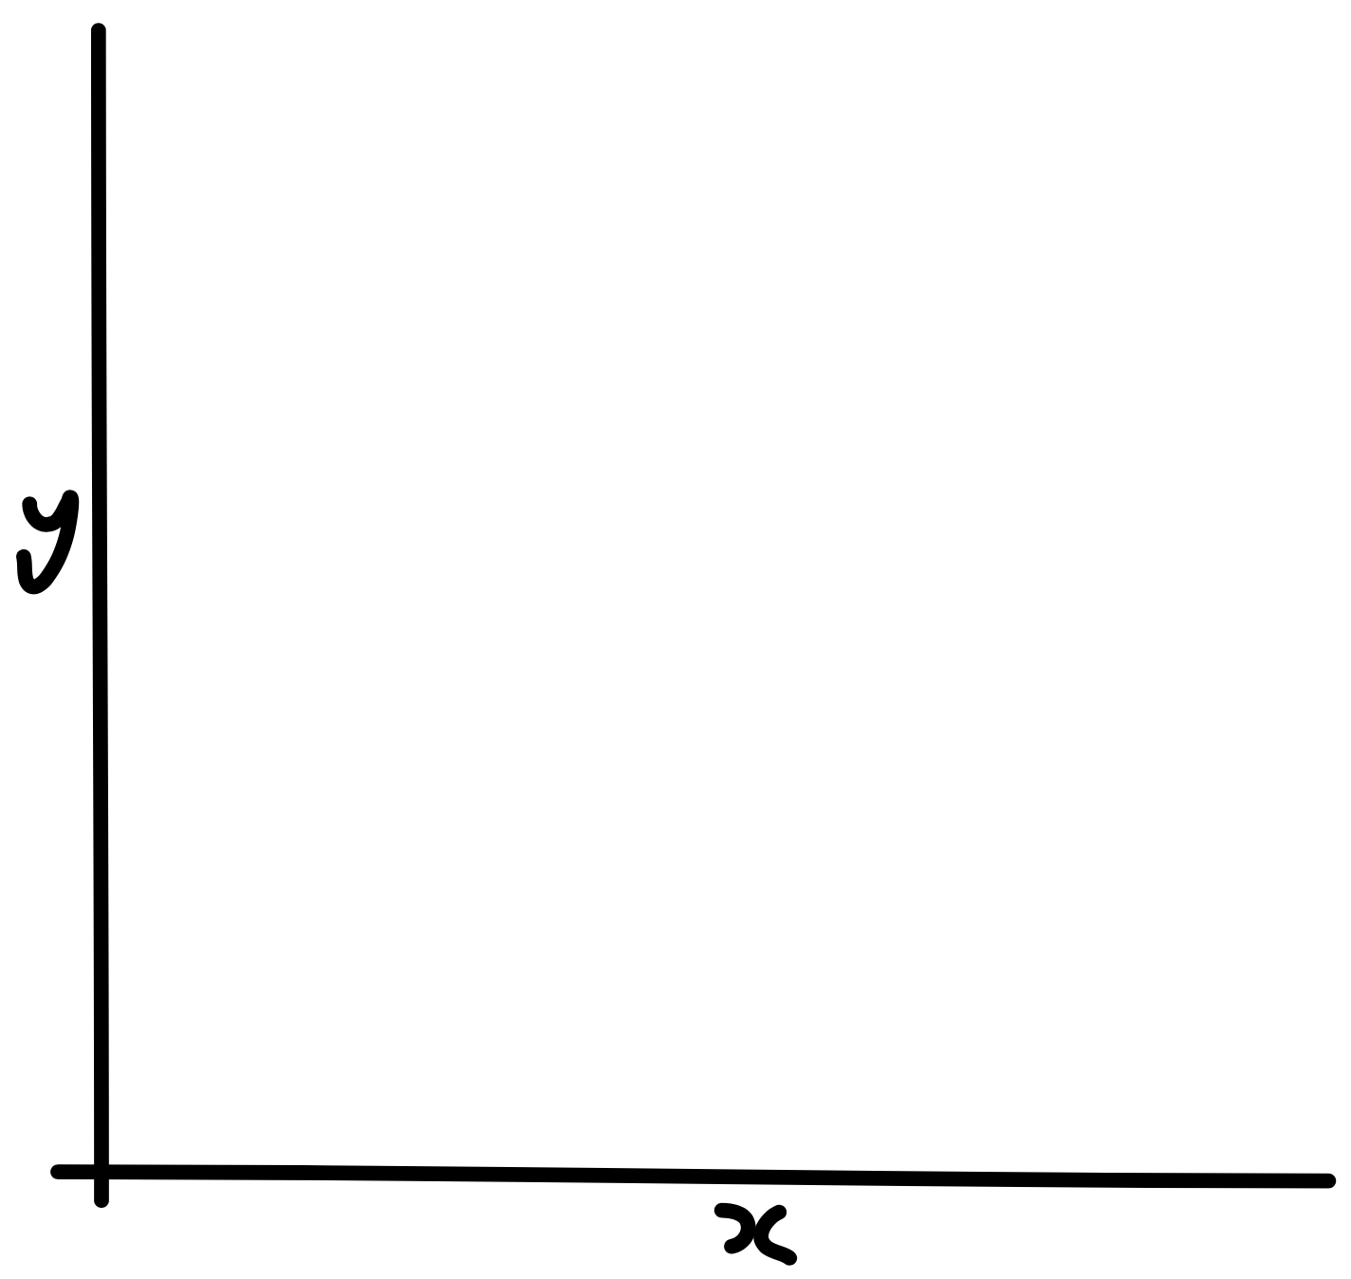
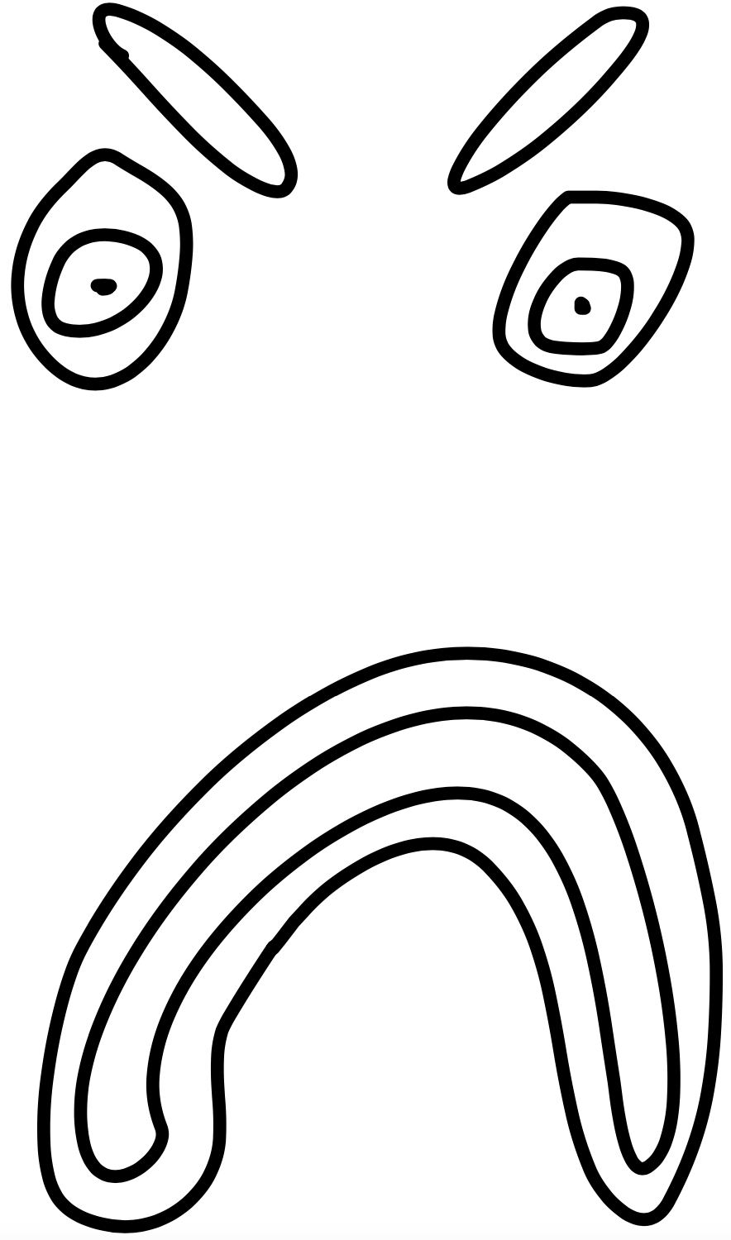
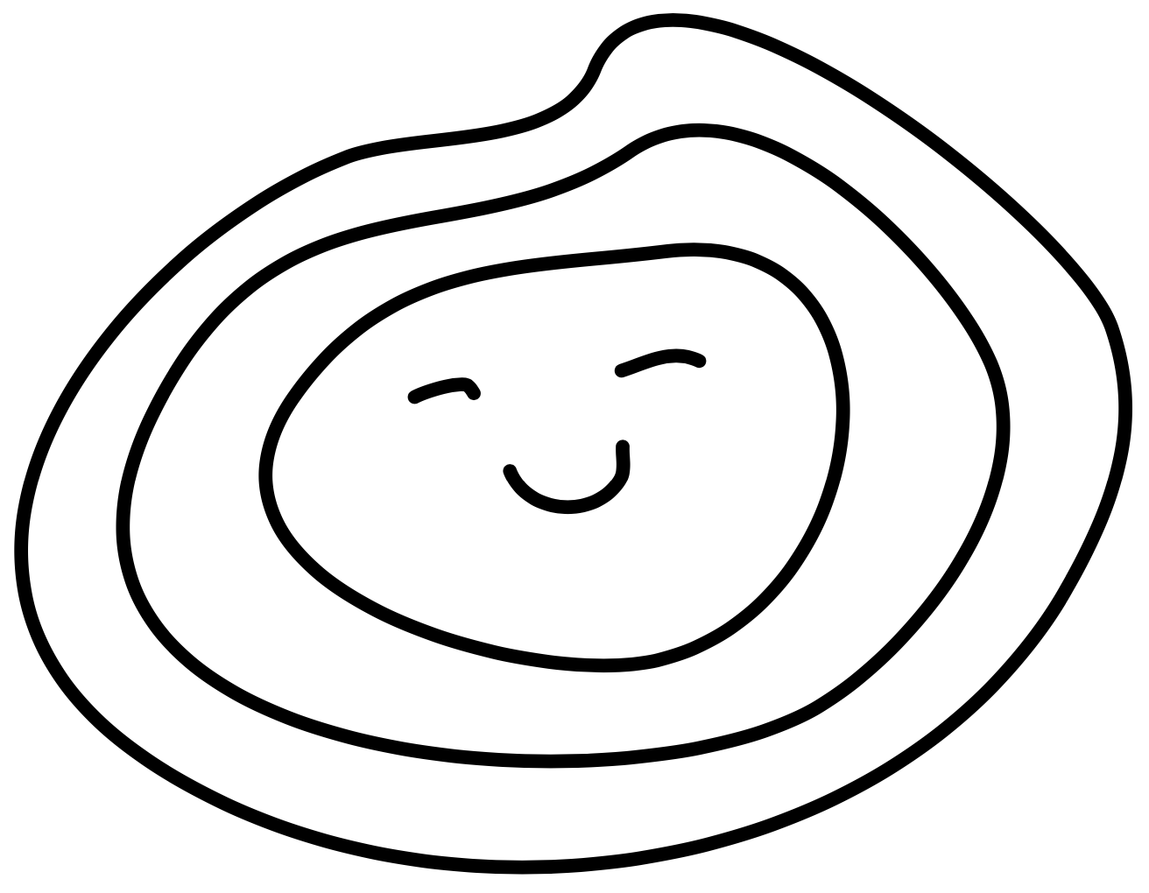
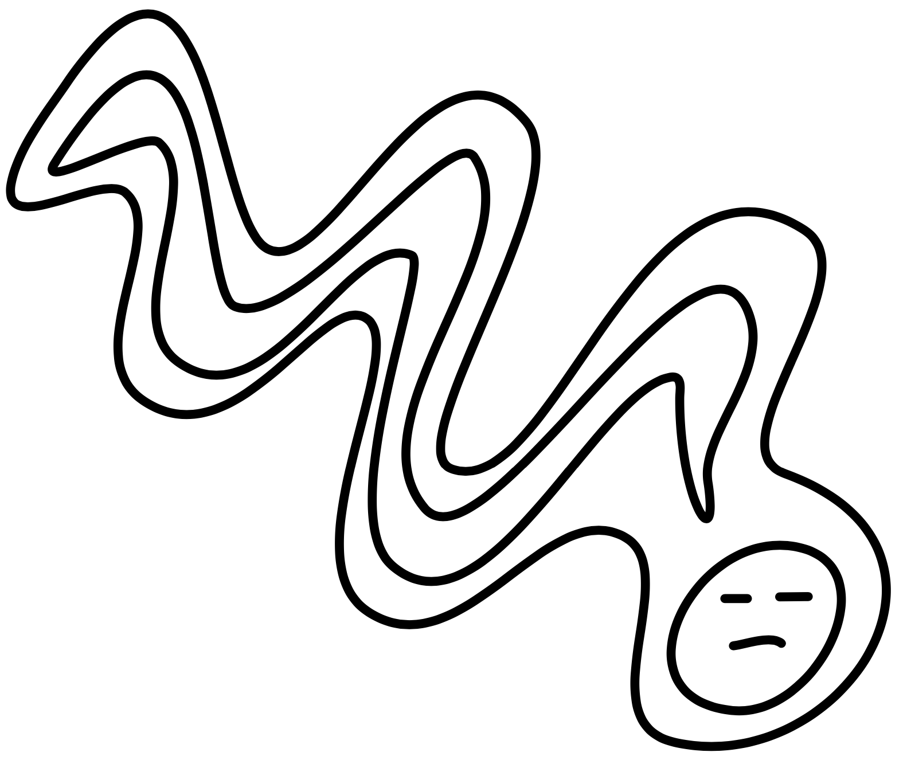
The three species of MCMC problem
The blob
The squiggle
The lump
Single peak
No strong correlations or narrow ridges
Vanilla Metropolis-Hastings
May have multiple peaks, but close together
Non-Gaussian areas, may include strong correlations
Hamiltonian Monte Carlo
Multiple disconnected peaks of different hights
May also have complex shape
Bespoke methods

Slide 6
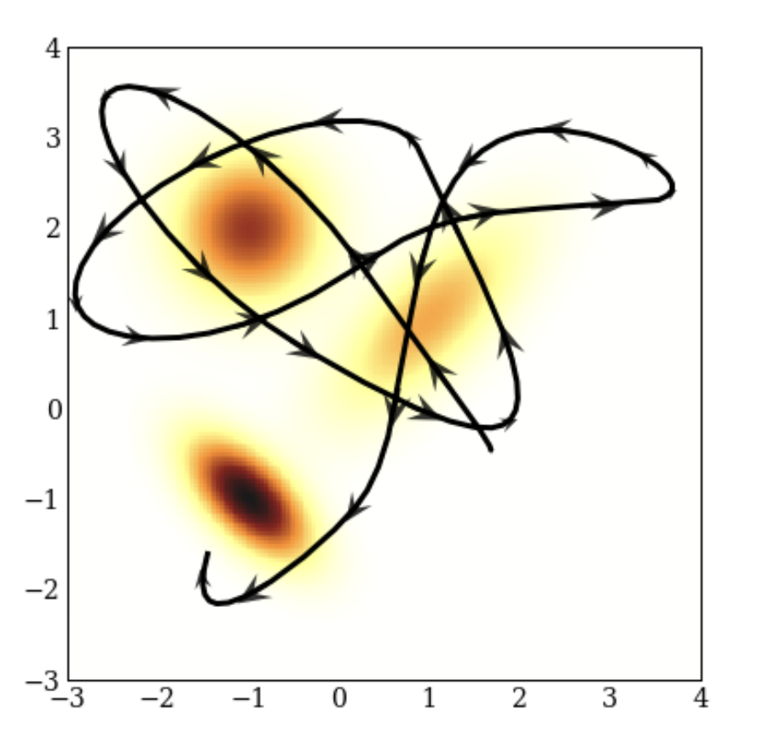
What not Hamiltonian Monte Carlo?
HMC is not designed to solve the problem of multi-modality
It struggles when peaks are well separated
https://colindcarroll.com/2019/04/11/hamiltonian-monte-carlo-from-scratch/

Slide 7
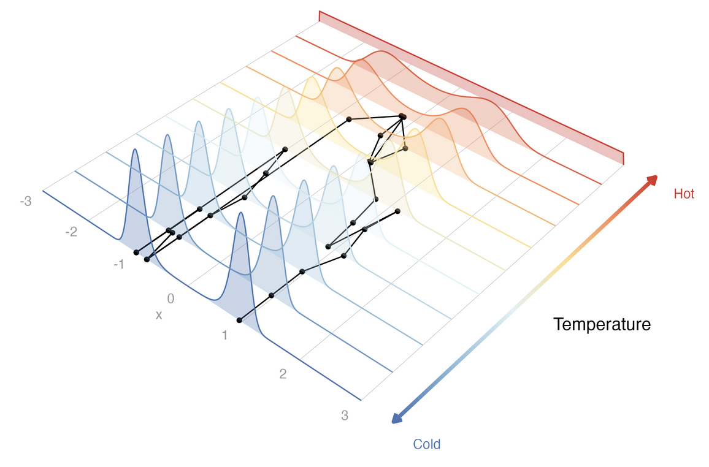
Parallel tempering
“Melts” likelihood by raising to a power
Model agnostic
Easy to implement – if you know how!
Some great recent work in this area
Can we abstract this away from the user?

Slide 8
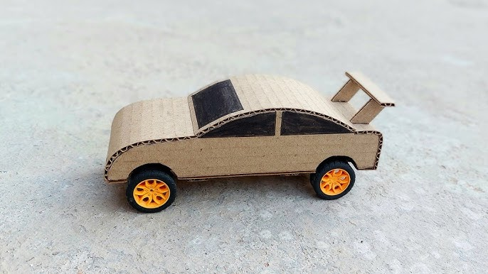
Streamlined MCMC in native R
We want to avoid
Packages that require deep mathematical understanding of PT
Custom statistical languages
We want to encourage
Good MCMC practice
Rapid prototyping and development
Ease of user experience (e.g. installation)

Slide 9
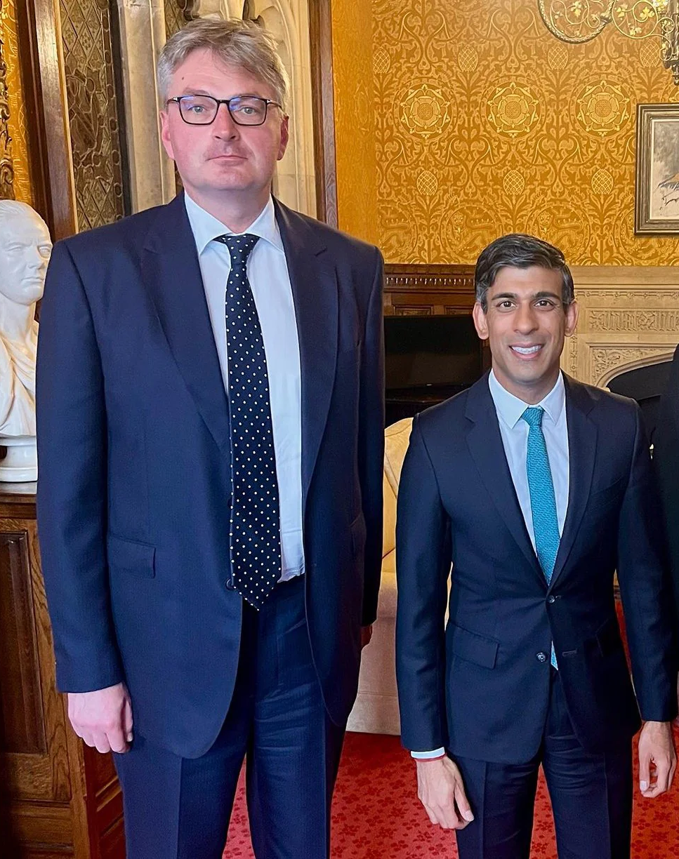
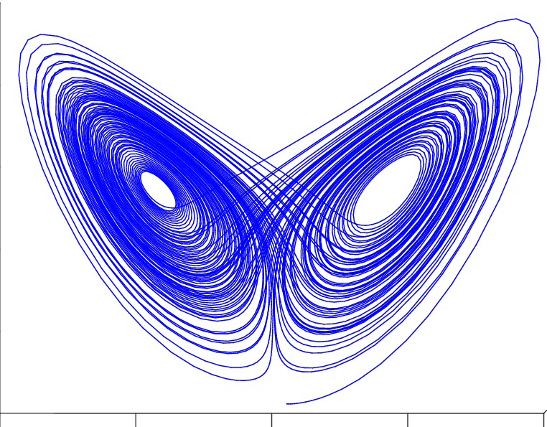
Caveats
Support is limited!
Not setup for discrete parameters
drjacoby not the ideal choice for “hard” problems
Very large data or parameters
More efficient samplers (e.g. Gibbs)
Crazy stuff
STAN
drjacoby

Slide 10
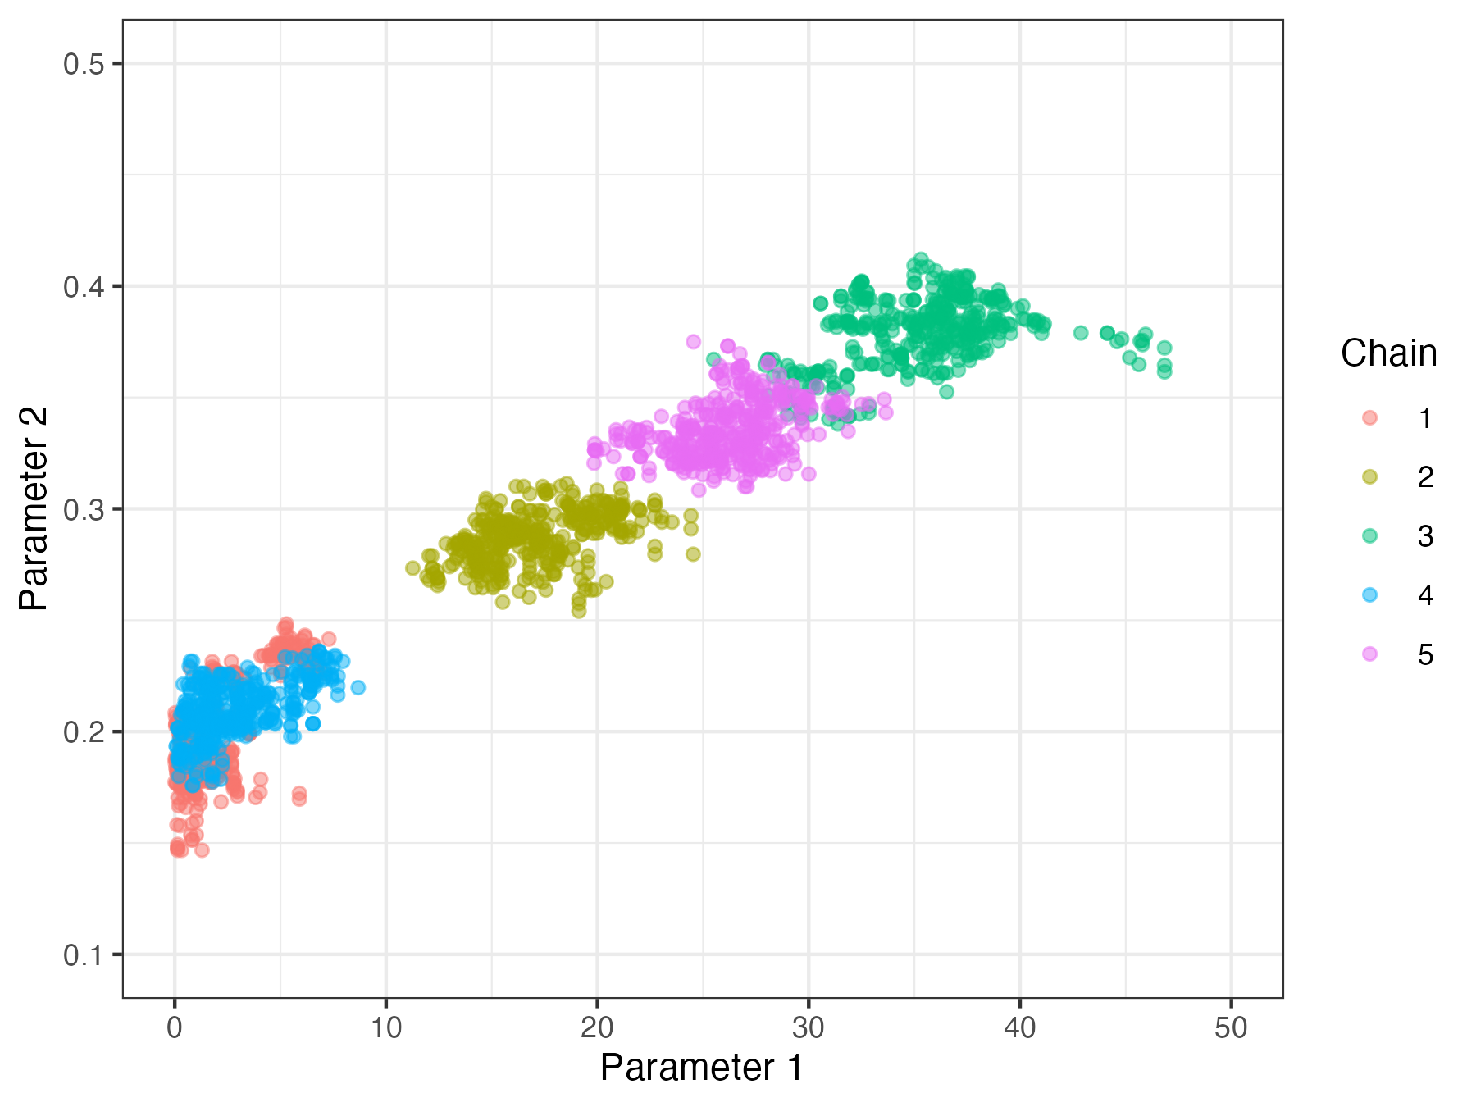
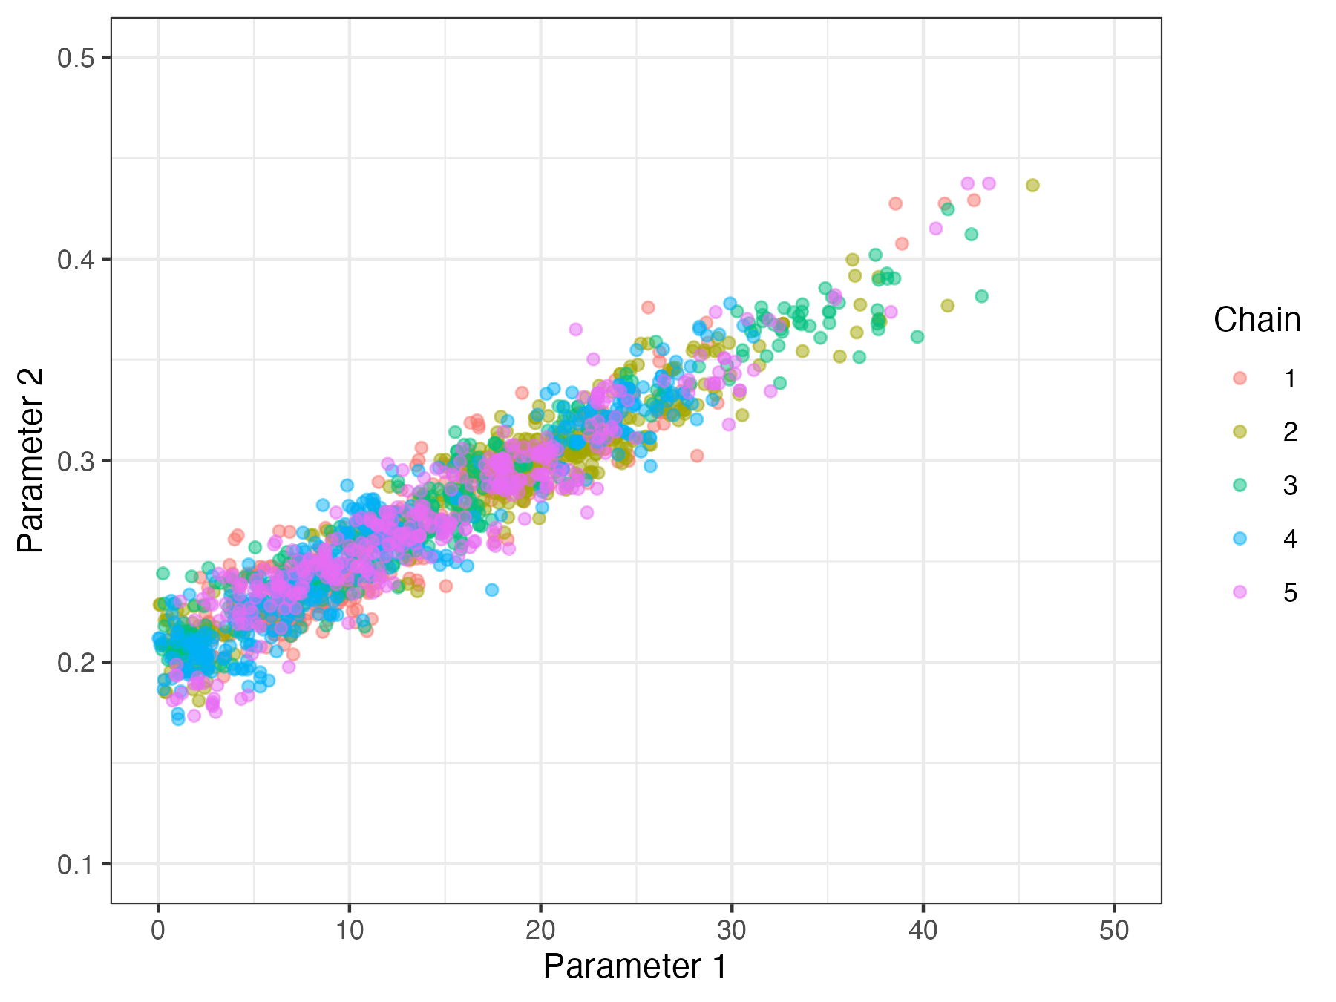
The sampling algorithm
Random-walk Metropolis-Hastings
Parallel tempering

Slide 11
Future plans
Integrate into mcstate
More automated tuning of temperature rungs
Implement some recent advances in PT theory
Follow community needs (you)
fit the malaria model!
Questions?

Slide 12
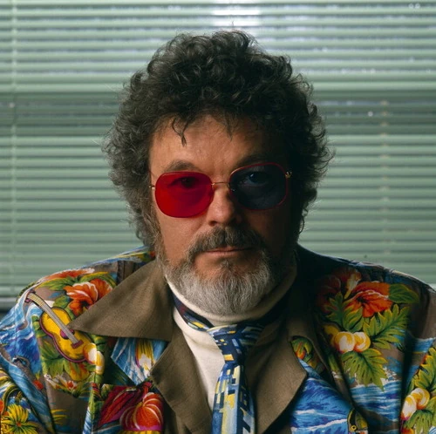
The original Dr Jacoby!

